Slide 1
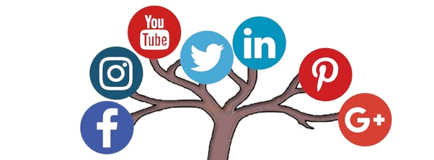
Social
Media
Marketing | Training

Slide 2
Module 1: Introduction to Social Media Marketing
Overview of Social Media Platforms
Importance of Social Media Marketing in Business
Current Trends and Statistics in Social Media Usage

Slide 3
Overview of Social Media Platforms
Facebook
Twitter
LinkedIn
Instagram
YouTube
Pinterest
Reddit
Snapchat
Tumblr
TikTok
Threads by Instagram
WhatsApp Business
WeChat
Telegram
Twitch

Slide 4
Overview of Social Media Platforms
Enhanced Brand Awareness
Increased Traffic and SEO Rankings
Lead Generation and Higher Conversion Rates
Cost-Effective Marketing Strategy
Better Customer Satisfaction
Reaches a vast audience quickly and efficiently.
Creates a strong online presence.
Facilitates brand recall and recognition.
Drives traffic to your website through shared content.
Improves search engine rankings due to social signals.
Enhances visibility and discoverability.
Drives traffic to your website through shared content.
Improves search engine rankings due to social signals.
Enhances visibility and discoverability.
Offers low-cost advertising options compared to traditional media.
Provides a high return on investment (ROI).
Allows for budget flexibility and scalable campaigns.
Facilitates real-time customer support and feedback.
Builds stronger customer relationships through engagement.
Personalizes the customer experience.
Improved Brand Loyalty
Marketplace Insights
Enhanced Customer Insights
Increased Engagement and Community Building
Global Reach and Expansion
Cultivates a loyal customer base through consistent interaction.
Encourages repeat business and long-term customer relationships.
Generates brand advocates and ambassadors.
Provides valuable data on customer preferences and behavior.
Monitors competitors and industry trends.
Informs strategic decision-making and product development.
Utilizes analytics tools to track and measure performance.
Understands audience demographics and interests.
Refines marketing strategies based on data-driven insights.
Fosters a sense of community around your brand.
Encourages user-generated content and organic promotion.
Enhances customer interaction and involvement.
Connects with a global audience regardless of geographical boundaries.
Expands market reach and opens new business opportunities.
Supports international marketing efforts.

Slide 5
Current Trends and Statistics in Social Media Usage
Increasing Social Media Adoption
Over 4.8 billion people worldwide use social media as of 2024.
Social media penetration rate stands at approximately 60% of the global population.
Platform Popularity and Growth
Facebook remains the largest platform with over 2.9 billion monthly active users.
Instagram boasts over 1.4 billion users, particularly popular among younger demographics.
TikTok has seen explosive growth, surpassing 1 billion users, driven by short-form video content.
Video Content Dominance
Video content accounts for over 80% of all internet traffic.
Platforms like YouTube, TikTok, and Instagram Reels have become central to social media strategies.
Live streaming is gaining popularity, with platforms like Facebook Live, Instagram Live, and Twitch leading the way.
Rise of Social Commerce
Social media shopping features are becoming more integrated, with platforms like Instagram, Facebook, and Pinterest offering seamless shopping experiences.
Influencer marketing continues to drive sales, with social commerce sales expected to reach $2 trillion by 2025.
Short-Form Content Popularity
Short-form video content (e.g., TikTok, Instagram Reels, YouTube Shorts) is highly engaging and preferred by users.
These formats are ideal for quick, impactful messages and brand visibility.
Influencer Marketing Growth
Influencer marketing is projected to be a $15 billion industry by 2024.
Micro-influencers (1,000 to 100,000 followers) are increasingly valued for their high engagement rates and niche audiences.
User-Generated Content (UGC)
UGC is seen as more authentic and trustworthy by consumers.
Brands are leveraging UGC for organic promotion and community building.
Augmented Reality (AR) and Virtual Reality (VR)
AR filters and VR experiences are enhancing user engagement.
Platforms like Snapchat and Instagram are leading in AR features.

Slide 6
Current Trends and Statistics in Social Media Usage
Ephemeral Content
Temporary content, such as Instagram Stories and Snapchat Snaps, drives high engagement due to its fleeting nature.
Brands use ephemeral content for behind-the-scenes glimpses and time-sensitive promotions.
Messaging Apps and Chatbots
Messaging apps like WhatsApp, Facebook Messenger, and WeChat are essential for customer service and direct communication.
Chatbots are improving customer interaction and providing instant responses.
Privacy and Data Security Concerns
Users are increasingly aware of data privacy issues.
Platforms are enhancing privacy features and transparency to build trust.
Community Building and Niche Networks
Smaller, niche social networks are gaining traction, focusing on specific interests and communities.
Platforms like Reddit and Discord cater to more focused and engaged user bases.
Social Media for Social Causes
Social media is a powerful tool for raising awareness and mobilizing support for social causes.
Movements like #BlackLivesMatter and #MeToo have shown the impact of social media in driving social change.
Emergence of New Platforms
New social media platforms like Clubhouse (audio-based social networking) are gaining popularity.
Constant innovation keeps the social media landscape dynamic and evolving.
Increasing Mobile Usage
Over 90% of social media users access platforms via mobile devices.
Mobile optimization is crucial for user experience and engagement.

Slide 7
Module 2: Creating a Social Media Strategy
Understanding Your Audience
Choosing the Right Social Media Platforms
Competitor Analysis and Benchmarking

Slide 8
Understanding Your Audience
Defining Your Target Audience
Identify demographics: age, gender, location, education, occupation, income.
Determine psychographics: interests, values, lifestyle, personality, attitudes.
Creating Buyer Personas
Develop detailed profiles representing segments of your target audience.
Include information such as goals, challenges, preferences, and behavior patterns.
Conducting Market Research
Use surveys, questionnaires, and focus groups to gather data directly from potential customers.
Analyze existing customer data from sales records, CRM systems, and website analytics.
Utilizing Social Media Analytics
Leverage platform-specific tools (e.g., Facebook Insights, Instagram Analytics, Twitter Analytics) to understand follower demographics and engagement.
Track metrics like reach, impressions, clicks, shares, and comments to gauge content performance.
Monitoring Online Behavior
Observe audience interactions with your content and competitors’ content.
Track social media trends, hashtags, and conversations relevant to your industry.
Segmenting Your Audience
Divide your audience into segments based on shared characteristics or behaviors.
Tailor content and campaigns to address the specific needs and preferences of each segment.
Listening to Customer Feedback
Pay attention to comments, reviews, and direct messages on social media.
Use feedback to improve products, services, and customer experiences
Analyzing Competitor Audiences
Study competitors’ social media followers and engagement strategies.
Identify gaps and opportunities to differentiate your brand.
Engaging with Your Audience
Foster two-way communication by responding to comments and messages.
Encourage user-generated content and participation in discussions.
Testing and Refining Strategies
Use A/B testing to compare different content and ad variations.
Continuously refine your approach based on performance data and audience reactions.
Leveraging Influencers and Advocates
Collaborate with influencers who resonate with your target audience.
Encourage satisfied customers to share their experiences and become brand advocates.
Understanding Cultural and Regional Differences
Adapt content to suit cultural and regional nuances of your audience.
Ensure inclusivity and sensitivity to diverse audience segments.
Using Advanced Analytics Tools
Implement tools like Google Analytics, Hootsuite, and Sprout Social for deeper insights.
Track user journeys, conversion rates, and social media ROI.
Staying Updated with Trends
Keep abreast of the latest social media trends and audience behavior changes.
Adjust your strategies to remain relevant and engaging.
Creating Relevant and Valuable Content
Develop content that addresses your audience’s pain points, interests, and aspirations.
Use storytelling, visuals, and interactive elements to capture and maintain attention.

Slide 9
Choosing the Right Social Media Platforms
Identify Your Goals and Objectives
Determine what you aim to achieve with social media marketing (e.g., brand awareness, lead generation, customer engagement).
Align platform choices with these goals to maximize impact.
Understand Your Target Audience
Research where your target audience spends their time online.
Consider demographics, interests, and behaviors to select platforms where your audience is most active.
Evaluate Platform Features and Capabilities
Assess the unique features of each platform (e.g., video, stories, live streaming, shopping).
Choose platforms that offer tools and formats that align with your content strategy.
Analyze Competitor Activity
Observe which platforms your competitors are using and how they are performing.
Identify successful strategies and opportunities for differentiation.
Consider Industry Relevance
Some platforms are more suitable for specific industries (e.g., LinkedIn for B2B, Instagram for fashion and lifestyle).
Select platforms that complement your industry’s needs and audience preferences.
Assess Resource Availability
Evaluate the resources (time, budget, personnel) available for managing each platform.
Avoid spreading your efforts too thin across too many platforms.
Review Platform Analytics and Insights
Utilize built-in analytics tools to measure platform performance.
Focus on platforms that provide actionable data and insights for optimizing your strategy.

Slide 10
Choosing the Right Social Media Platforms
Leverage Platform-Specific Strengths
Capitalize on platforms’ strengths to achieve specific marketing goals:
Facebook: Wide reach, diverse audience, advanced advertising tools.
Instagram: Visual storytelling, high engagement, younger demographics.
Twitter: Real-time updates, trending topics, customer service.
LinkedIn: Professional networking, B2B marketing, thought leadership.
TikTok: Short-form video content, viral potential, Gen Z audience.
Pinterest: Visual discovery, inspiration, e-commerce.

Slide 11
Choosing the Right Social Media Platforms
Consider Content Type and Format
Match the platform to your content types (e.g., video, images, articles, infographics).
Use platforms that enhance the visibility and engagement of your content formats.
Evaluate Engagement Levels
Choose platforms where your audience actively engages with content.
Focus on platforms that foster community building and interaction.
Monitor Emerging Platforms
Stay updated on new and emerging social media platforms.
Experiment with new platforms to tap into early adopter audiences.
Assess Advertising Options
Evaluate the advertising capabilities of each platform.
Choose platforms that offer effective targeting and ad formats for your campaigns.
Test and Iterate
Start with a few key platforms and measure performance.
Adjust your platform strategy based on results and audience feedback.
Maintain Consistency Across Platforms
Ensure a consistent brand voice and messaging across all chosen platforms.
Adapt content to fit each platform’s unique style and audience expectations.
Consider Long-Term Viability
Choose platforms that are likely to remain relevant and popular in the long term.
Avoid relying too heavily on platforms that may have uncertain futures.

Slide 12
Competitor Analysis and Benchmarking
Understand your competitive landscape to identify opportunities and improve your social media strategy.
Analyze Competitor Profiles
Evaluate Content Performance
Examine Engagement Tactics
Identify Opportunities
Benchmark Metrics
Direct: Businesses offering similar products/services. Indirect: Businesses in related industries or markets
Social media platforms used Follower count and engagement rates Content themes and strategies Posting frequency and timing
Identify top-performing posts (likes, shares, comments) Analyze content types (videos, images, articles) Assess visual and messaging style
Customer interaction and response time Use of influencers and partnerships Community-building activities
Compare key performance indicators (KPIs) like engagement rate, reach, and follower growth Identify gaps and areas for improvement
Spot content or engagement gaps Leverage strengths and address weaknesses Innovate with unique value propositions
Assess Advertising Strategies
Ad formats and creative Targeting and audience segmentation Budget and spending patterns
Identify Competitors

Slide 13
Module 3: Content Creation and Curation
Types of Content That Work on Different Platforms (Text, Images, Videos, Infographics)
Developing a Content Calendar
Tools and Resources for Content Creation
Copyright and Legal Considerations

Slide 14
Types of Content That Work on Different Platforms
Text Posts: Short updates, questions, and status updates. Images: High-quality photos, memes, and infographics. Videos: Live videos, recorded videos, and short clips. Links: Blog posts, articles, and curated content.
Videos: Short-form videos (up to 60 seconds), challenges, trends, and user-generated content.
Text Overlays: Brief captions and text within videos for emphasis.
Images: High-resolution photos, user-generated content, behind-the-scenes shots.
Videos: Reels, Stories, IGTV, and short promotional videos.
Text Overlays: Quotes and inspirational messages on images.
Infographics: Visually appealing infographics for educational content.
Images: High-quality, vertical images, DIY projects, and lifestyle photos.
Infographics: Step-by-step guides and how-tos.
Videos: Short tutorial videos and inspirational content.
Text Overlays: Tips, quotes, and descriptions on images.
Text Posts: Short, concise updates, news, and announcements (up to 280 characters).Images: Photos, GIFs, and memes.
Videos: Short videos and clips (up to 2 minutes and 20 seconds).
Links: Articles, blog posts, and curated content with brief commentary.
Videos: Long-form videos, tutorials, vlogs, product reviews, and educational content.
Shorts: Brief, engaging clips (up to 60 seconds).
Text Posts: Professional updates, industry news, and thought leadership.
Images: Infographics, charts, and professional photos.
Videos: Industry insights, webinars, and how-to videos.
Articles: Long-form content and blog posts.
Videos: Short, ephemeral videos and stories.
Images: Photos with filters and overlays.
Text Overlays: Captions and brief messages on photos and videos.

Slide 15
Types of Content That Work on Different Platforms
Consistency: Maintain a consistent posting schedule to keep your audience engaged.
Quality: Focus on high-quality visuals and well-crafted messages.
Relevance: Tailor content to the platform's audience and preferences.
Engagement: Encourage interaction through comments, likes, and shares.
Analytics: Regularly review performance metrics to optimize content strategy.

Slide 16
Developing a Content Calendar
1. Define Your Goals
Brand Awareness: Increase reach and visibility. Engagement: Boost likes, comments, shares, and interactions. Lead Generation: Drive traffic to your website or landing pages. Sales: Promote products or services to boost sales.
2. Understand Your Audience:
Demographics: Age, gender, location, interests.
Behavior: Preferred content types, engagement patterns, and peak activity times.
3. Choose Your Platforms:
Select platforms based on where your audience is most active and your goals.
Consider Facebook, Instagram, Twitter, LinkedIn, TikTok, Pinterest, etc.
4. Plan Content Types:
Text: Blog posts, articles, quotes.
Images: Photos, infographics, memes.
Videos: Tutorials, live videos, reels, stories.
Links: Curated content, news, resources.
Interactive Content: Polls, quizzes, contests.
5. Set a Posting Frequency:
Daily: Instagram Stories, Tweets.
Weekly: Blog posts, LinkedIn articles.
Monthly: Newsletters, in-depth videos.

Slide 17
Developing a Content Calendar
6. Create a Content Mix:
7. Schedule Content:
8. Create a Content Calendar Template:
9. Fill in Your Calendar:
10. Review and Adjust:
Educational: How-to, tutorials, industry news.
Inspirational: Quotes, succès stories, motivationnel content.
Promotional: Product launches, discounts, sales.
Engagement: Polls, questions, user-generated content.
Entertainment: Memes, fun facts, behind-the-scenes.
Use tools like Hootsuite, Buffer, or Trello to organize and schedule posts.
Plan for key dates, holidays, and industry events.
Ensure a consistent posting schedule.
Columns: Date, Time, Platform, Content Type, Description, Media, Status.
Rows: Individual content pieces.
Map out content for a month or quarter.
Balance different content types and themes.
Leave room for spontaneous or reactive content.
Regularly review performance metrics.
Adjust your strategy based on what works and what doesn't.
Stay flexible to accommodate changes and trends.

Slide 18
Developing a Content Calendar
Sample Content Calendar:
Date | Time | Platform | Content Type | Description | Media | Status
July 10 | 10 AM | Facebook | Image | Motivational Quote | Quote Image | Scheduled
July 11 | 2 PM | Instagram | Video | Product Tutorial | Tutorial Video | Scheduled
July 12 | 1 PM | Twitter | Text | Blog Post Promotion | Blog Post Link | Scheduled
July 13 | 11 AM | LinkedIn | Article | Industry Insight Article | Article Link | Draft
July 14 | 3 PM | Pinterest | Infographic | DIY Project Steps | Infographic Image | Scheduled
July 15 | 9 AM | TikTok | Video | Behind-the-Scenes Clip | BTS Video Clip | Draft
July 16 | 5 PM | Instagram | Poll | Customer Feedback Poll | Poll Question | Scheduled
Tips:
Consistency: Maintain a regular posting schedule.
Variety: Keep your content diverse to engage different audience segments.
Engagement: Monitor and respond to audience interactions.
Analysis: Use analytics tools to track performance and refine your strategy.

Slide 19
Tools and Resources for Content Creation
Graphic Design
Video Creation and Editing
Image Editing
Content Planning and Scheduling
Writing and Copy Editing
Stock Photos and Videos
Infographic Creation
Animation and Interactive Content
Social Media Analytics
Content Curation
SEO and Keyword Research
Collaboration and Project Management

Slide 20
Tools and Resources for Content Creation
Graphic Design
Canva: User-friendly design tool for creating social media graphics, infographics, posters, and more.
Adobe Spark: Easy-to-use tool for creating graphics, web pages, and video stories.
PicMonkey: Design tool for photo editing and creating social media graphics.

Slide 21
Tools and Resources for Content Creation
Video Creation and Editing:
Adobe Premiere Pro: Professional video editing software.
Final Cut Pro: Advanced video editing software for Mac users.
iMovie: Basic video editing tool for Mac users.
InVideo: Online video editor with templates for social media content.
Animoto: Easy-to-use video maker for creating marketing videos.

Slide 22
Tools and Resources for Content Creation
Image Editing
Adobe Photoshop: Industry-standard image editing software.
GIMP: Free, open-source image editor with advanced features.
Lightroom: Photo editing and management software from Adobe.

Slide 23
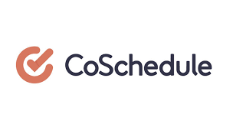
Tools and Resources for Content Creation
Content Planning and Scheduling
Hootsuite: Social media management platform for scheduling and analyzing posts.
Buffer: Tool for scheduling posts and tracking engagement.
Trello: Project management tool for organizing content ideas and tasks.
CoSchedule: Marketing calendar tool for planning, scheduling, and organizing content.

Slide 24
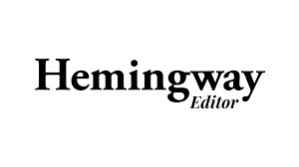
Tools and Resources for Content Creation
Writing and Copy Editing
Grammarly: Writing assistant for grammar and spell-checking.
Hemingway Editor: Tool for improving readability and style.
Google Docs: Collaborative word processing tool for content creation.

Slide 25
Tools and Resources for Content Creation
Stock Photos and Videos
Unsplash: High-quality, free stock photos.
Pexels: Free stock photos and videos.
Shutterstock: Premium stock photos, videos, and music.

Slide 26
Tools and Resources for Content Creation
Infographic Creation
Venngage: Infographic maker with customizable templates.
Piktochart: Tool for creating infographics, presentations, and printables.
Infogram: Infographic and data visualization tool.

Slide 27
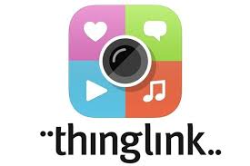
Tools and Resources for Content Creation
Animation and Interactive Content
Animaker: Tool for creating animated videos and presentations.
Powtoon: Platform for creating animated explainer videos and presentations.
ThingLink: Tool for creating interactive images and videos.

Slide 28
Tools and Resources for Content Creation
Social Media Analytics
Sprout Social: Social media management and analytics platform.
Google Analytics: Tool for tracking website and social media traffic.
Socialbakers: AI-powered social media marketing platform for analytics and management.

Slide 29
Tools and Resources for Content Creation
Content Curation
Feedly: Content aggregator for discovering and organizing relevant content.
Pocket: Tool for saving and curating articles, videos, and web pages.
BuzzSumo: Tool for discovering popular content and trends.

Slide 30
Tools and Resources for Content Creation
SEO and Keyword Research
Ahrefs: SEO toolset for backlink and keyword research.
SEMrush: Comprehensive SEO and marketing toolkit.
Google Keyword Planner: Free tool for keyword research.

Slide 31
Tools and Resources for Content Creation
Collaboration and Project Management
Asana: Project management tool for team collaboration.
Slack: Communication platform for team collaboration and messaging.
Monday.com: Work operating system for managing projects and workflows.

Slide 32
Tools and Resources for Content Creation
Tips for Effective Content Creation
Consistency: Use templates and brand guidelines to maintain a consistent look and feel.
Quality: Invest in high-quality visuals and professional editing tools.
Engagement: Create interactive and engaging content to foster audience interaction.
Optimization: Use SEO tools to optimize content for search engines.
Analysis: Regularly review analytics to understand what works and adjust your strategy accordingly.

Slide 33
Copyright and Legal Considerations in Social Media Marketing
Understanding Copyright:
Definition: Copyright is a legal right that grants the creator of original work exclusive rights to its use and distribution.
Protected Works: Includes text, images, videos, music, software, and other creative works.
Using Third-Party Content:
Permission: Always obtain permission before using copyrighted material.
Licensing: Use content under proper licenses (e.g., Creative Commons).Attribution: Give appropriate credit to the original creator as required.
Fair Use Doctrine:
Criteria: Fair use depends on the purpose, nature, amount, and effect of the use on the market value of the original work.
Examples: Commentary, criticism, news reporting, teaching, and research may qualify as fair use.
Stock Photos and Videos:
Licensed Content: Use images and videos from licensed sources (e.g., Shutterstock, Adobe Stock).
Free Resources: Verify the usage rights of free stock content (e.g., Unsplash, Pexels).
User-Generated Content (UGC):
Permission: Obtain explicit consent from users before sharing their content.
Terms of Use: Clearly outline UGC policies in your social media guidelines.
Trademarks and Logos:
Brand Names and Logos: Do not use trademarks or logos without permission.
Parody and Satire: Ensure the use of trademarks in parodies is clearly distinguishable from the original brand.
Influencer Partnerships:
Disclosures: Ensure influencers disclose paid partnerships as required by law.
Contracts: Have clear agreements outlining content ownership and usage rights.
Contests and Giveaways:
Rules and Regulations: Clearly state the rules, eligibility, and terms of participation.
Platform Policies: Comply with the specific platform’s guidelines for running promotions.
Data Privacy:
Regulations: Comply with data privacy laws (e.g., GDPR, CCPA).User Consent: Obtain consent before collecting and using personal data.
Privacy Policy: Clearly communicate your privacy practices to users.
Intellectual Property (IP) Infringement:
Monitoring: Regularly monitor your content for potential IP violations.
Take Down Requests: Respect and promptly respond to take down requests for infringing content.
Contracts and Agreements:
Content Creation: Have clear contracts with content creators detailing ownership and usage rights.
Distribution: Ensure agreements cover distribution channels and usage limits.
Record Keeping:
Documentation: Keep records of permissions, licenses, and contracts.
Audit Trail: Maintain an audit trail of content usage and approvals.

Slide 34
Copyright and Legal Considerations in Social Media Marketing
Best Practices
Education: Stay informed about copyright laws and updates.
Policies: Develop and enforce clear copyright and content usage policies.
Legal Advice: Consult with legal professionals for complex issues or uncertainties.
Training: Educate your team on copyright compliance and legal considerations.
Summary
Respect Rights: Always respect the intellectual property rights of others.
Clear Permissions: Obtain clear permissions and use content legally.
Transparency: Be transparent about data usage and partnerships.
Compliance: Stay compliant with laws and platform policies to avoid legal issues.

Slide 35
Module 4: Building and Growing Your Community
Techniques for Increasing Followers and Engagement
Effective Use of Hashtags and Trends
Engaging with Your Audience (Responding to Comments, Messages)
Influencer Marketing Strategies

Slide 36
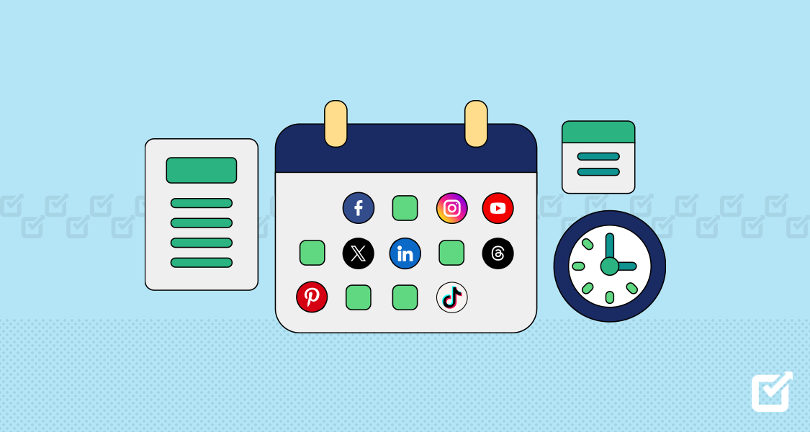
Techniques for Increasing Followers and Engagement
1. Consistent Posting Schedule
Regular Updates: Post consistently to keep your audience engaged and attract new followers.
Optimal Times: Post during peak engagement times specific to each platform.
2. High-Quality Content
Visual Appeal: Use high-quality images, videos, and graphics.
Value-Driven: Provide valuable, informative, and entertaining content.
Diverse Formats: Mix content types like text, images, videos, infographics, and stories.

Slide 37
Techniques for Increasing Followers and Engagement
3. Engage with Your Audience
Respond to Comments: Acknowledge and reply to comments promptly.
Ask Questions: Encourage conversations by asking questions in your posts.
User-Generated Content: Share and celebrate content created by your followers.
4. Use Hashtags Effectively:
Relevant Hashtags: Use popular and relevant hashtags to increase discoverability.
Branded Hashtags: Create unique hashtags for your brand to build community.

Slide 38
Techniques for Increasing Followers and Engagement
5. Collaborate with Influencers
Influencer Partnerships: Partner with influencers who align with your brand values.
Sponsored Posts: Use influencers to create sponsored content that reaches their followers.
6. Run Contests and Giveaways:
Exciting Prizes: Offer attractive prizes to encourage participation.
Simple Entry: Make it easy to enter by liking, sharing, tagging, or following.
Clear Rules: Ensure the rules are simple and clearly stated.

Slide 39
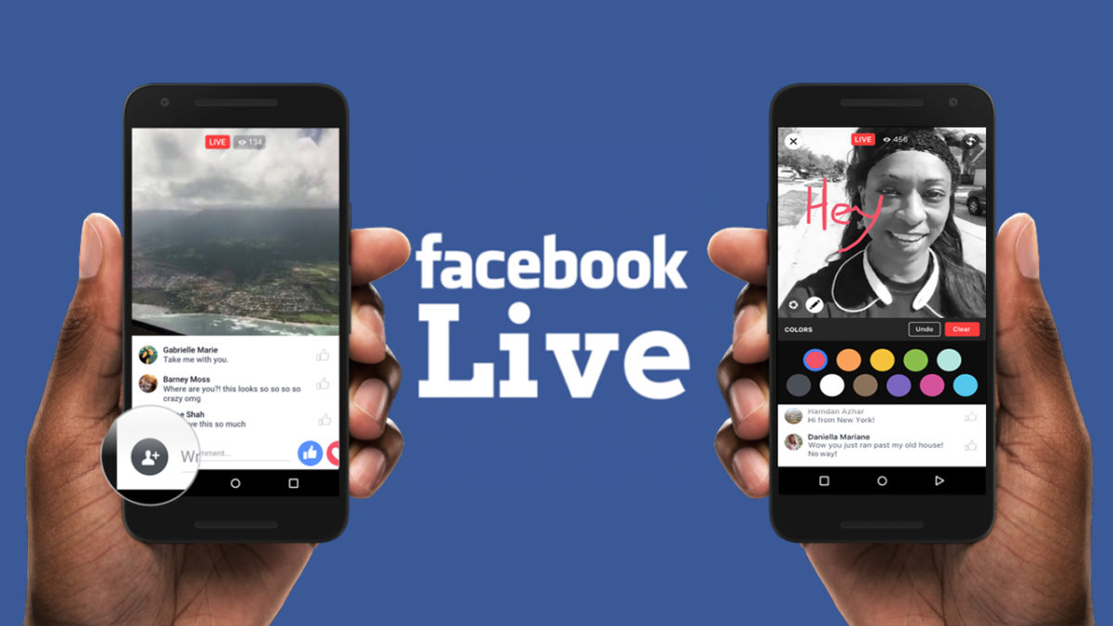
Techniques for Increasing Followers and Engagement
7. Utilize Stories and Live Videos
Behind-the-Scenes: Share behind-the-scenes content to create a personal connection.
Live Q&A: Host live sessions to engage directly with your audience.
Polls and Quizzes: Use interactive features to keep your audience engaged.
8. Leverage Paid Advertising
Targeted Ads: Use social media ads to target specific demographics and interests.
Sponsored Posts: Boost high-performing posts to reach a wider audience.
9. Cross-Promote on Other Platforms
Social Media Cross-Promotion: Promote your social media accounts on your website, email newsletters, and other platforms.
Collaboration with Brands: Partner with other brands for mutual promotion.

Slide 40
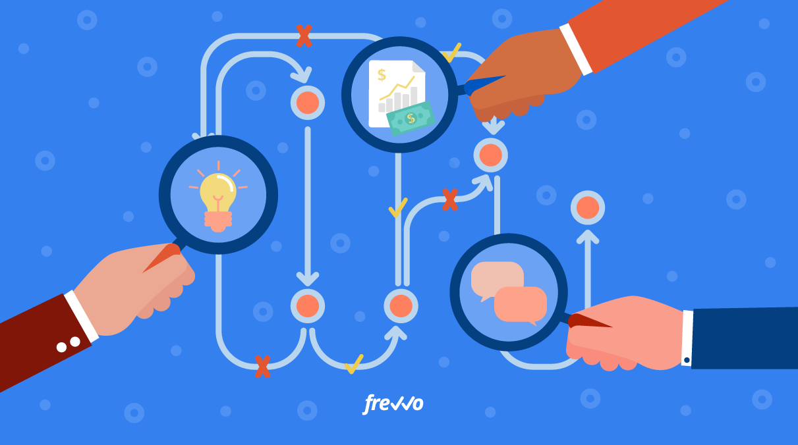
Techniques for Increasing Followers and Engagement
10. Analyze and Optimize
Analytics Tools: Use analytics to track performance and understand what content works best.
A/B Testing: Experiment with different types of content, captions, and posting times.
11. Engaging Captions and CTAs
Compelling Captions: Write engaging captions that prompt users to take action.
Clear CTAs: Use clear calls-to-action encouraging likes, shares, comments, and follows.
12. Participate in Trends and Challenges
Trending Hashtags: Participate in popular trends and challenges to increase visibility.
Timely Content: Create timely content related to current events and trends.

Slide 41
Techniques for Increasing Followers and Engagement
13. Network and Engage in Communities
Join Groups: Participate in relevant groups and communities.
Comment on Other Posts: Engage with posts from other users and brands.
14. Optimize Profiles
Profile Picture and Bio: Use a recognizable profile picture and write a clear, engaging bio.
Contact Information: Ensure your contact information and links are up to date.
15. Offer Exclusive Content
Exclusive Offers: Provide special discounts or content available only to your followers.
Sneak Peeks: Share previews of upcoming products or events.

Slide 42
Techniques for Increasing Followers and Engagement
Summary
Consistency and Quality: Regularly post high-quality content that provides value to your audience.
Engagement and Interaction: Actively engage with your audience through comments, questions, and interactive content.
Promotion and Collaboration: Use hashtags, influencers, and paid ads to increase reach and visibility.
Optimization: Continuously analyze performance and refine your strategy to meet your audience's preferences and behavior.

Slide 43
Effective Use of Hashtags and Trends
1. Understand Hashtags
Definition: Hashtags are keywords or phrases preceded by the "#" symbol, used to categorize content and make it discoverable.
Purpose: They increase the visibility of your content by making it searchable to users interested in specific topics.
2. Types of Hashtags
Branded Hashtags: Unique to your brand, used for campaigns or promotions (e.g., #NikeRun).
Industry Hashtags: Common within your industry (e.g., #MarketingTips, #FitnessGoals).
Community Hashtags: Used by communities with shared interests (e.g., #Foodies, #TravelBlogger).
Event Hashtags: Specific to events or holidays (e.g., #BlackFriday, #SuperBowl).
Location Hashtags: Geographical tags to reach local audiences (e.g., #NYC, #LondonLife).
3. Research and Choose Relevant Hashtags
Trending Hashtags: Monitor trending hashtags relevant to your industry or audience.
Hashtag Tools: Use tools like Hashtagify, RiteTag, and Keyhole to discover popular and relevant hashtags.
Competitor Analysis: Observe which hashtags your competitors are using successfully.

Slide 44
Effective Use of Hashtags and Trends
4. Best Practices for Using Hashtags
Relevance: Use hashtags that are relevant to your content and audience.
Mix of Popular and Niche Hashtags: Combine widely used hashtags with more specific ones to balance reach and competition.
Limit Number of Hashtags: Overloading posts with hashtags can look spammy. Use the optimal number for each platform (e.g., up to 11 on Instagram, 1-2 on Twitter).
5. Platform-Specific Hashtag Strategies
Instagram: Use up to 30 hashtags in posts, and include hashtags in Stories and bio.
Twitter: Limit to 1-2 hashtags per tweet to avoid clutter.
LinkedIn: Use 3-5 hashtags in posts for better engagement.
Facebook: Use fewer hashtags (1-3) to keep posts clean and readable.
TikTok: Combine trending hashtags with niche ones to reach a broader audience.
6. Engaging with Trends
Stay Current: Follow industry news, social media updates, and trending topics.
Create Timely Content: Post content that relates to current events, holidays, or viral trends.
Participate in Challenges: Join social media challenges and encourage your audience to participate.

Slide 45
Module 5: Advertising on Social Media
Introduction to Social Media Advertising Platforms (Facebook Ads, Instagram Ads, LinkedIn Ads, etc.)
Targeting Options and Audience Segmentation
Creating Compelling Ad Copy and Visuals
Budgeting and Bidding Strategies

Slide 46
Introduction to Social Media Advertising Platforms
Overview of Social Media Advertising:
Purpose: Social media advertising allows businesses to promote their products, services, or brand to a targeted audience through paid advertisements on various social media platforms.
Benefits: Precise targeting, cost-effective campaigns, measurable results, and wide reach.

Slide 47
Facebook Ads:
Audience Reach: With over 2.9 billion monthly active users, Facebook offers one of the largest audiences for advertisers.
Ad Formats: Image ads, video ads, carousel ads, slideshow ads, collection ads, and lead ads.
Targeting Options: Demographics, interests, behaviors, custom audiences (e.g., website visitors, email lists), and lookalike audiences.
Placement: Ads can appear in the news feed, right column, marketplace, stories, and in-stream videos.
Ad Manager: Facebook Ads Manager allows for campaign creation, budget setting, performance tracking, and optimization.

Slide 48
Module 6: Analytics and Performance Tracking
Key Metrics to Track (Reach, Engagement, Conversion Rates)
Tools for Analytics (Google Analytics, Social Media Insights)
Interpreting Data and Making Data-Driven Decisions
A/B Testing and Optimization Techniques

Slide 49
Module 7: Social Media Crisis Management
Identifying Potential Crisis Situations
Developing a Crisis Management Plan
Handling Negative Comments and Feedback
Case Studies and Examples of Successful Crisis Management

Slide 50
Module 8: Legal and Ethical Considerations
Privacy and Data Protection Laws (GDPR, CCPA)
FTC Guidelines for Sponsored Content and Endorsements
Intellectual Property Rights (Copyright, Trademarks)
Creating a Social Media Policy for Your Organization

Slide 51
Module 9: Future Trends in Social Media Marketing
Emerging Technologies (AI, VR/AR) and Their Impact
The Rise of Ephemeral Content (Stories)
Predictions for the Future of Social Media Platforms
Adaptation and Evolution of Social Media Marketing Strategies

Slide 52
Module 10: Practical Exercises and Case Studies
Developing a Social Media Marketing Plan for a Business
Analyzing Case Studies of Successful Social Media Campaigns
Hands-on Practice with Social Media Tools and Platforms
Q&A and Discussion Sessions

